Slide 1
How to Ask for a Letter of Recommendation

Slide 2
Whom to Ask
Ask faculty and REU supervisors who know you through mentorship and extensive conversations about careers and scholarship.

Slide 3
Whom to Ask
An evaluation is only as good as a recommender’s detailed knowledge of you.

Slide 4
Whom to Ask
Never presume that a faculty member owes you a recommendation nor should you take refusal personally.

Slide 5
Whom to Ask
Recommenders must know you sufficiently well to ensure that you will be a good fit for a grad program or REU. For our team, that means Shift Leaders who I’ve directly supervised and who have earned A’s and B’s in my classes

Slide 6
Whom to Ask
Faculty never want to burn bridges by recommending the wrong applicant.

Slide 7
How to Ask
1. Request an appointment and ask in person at least 6 weeks before your submission deadline. 2. Give your recommender a month.

Slide 8
How to Ask
2. Know your target programs (e.g., PhD in Neuroscience). 3. Ask whether the recommender knows you well enough to write you a strong letter.

Slide 9
Do Your Homework
Do your investigative work at the front end so that you have a complete list of programs for your recommenders.

Slide 10
Do Your Homework
This will help your recommenders manage their workflow.

Slide 11
What You Should Never Do
1. Submit your recommender’s name before receiving their permission. 2. Give your recommender 1- or 2-weeks lead time “because you were busy.”
3. Tell your recommender that you don’t have time to meet with them to discuss a letter.

Slide 12
What You Should Never Do
4. “Columbo” your recommender with successive requests.

Slide 13
What to Provide
Ask your recommenders whether they want electronic copy, hard copy, or both. Deliver your materials at one time. Package envelopes and hard copy in a sealable folder to prevent loss of materials.

Slide 14
What to Provide
Don’t assume that your professor has a detailed knowledge of your accomplishments.

Slide 15
What to Provide
1. Unofficial transcript from DegreeWorks (highlight their courses).

Slide 16
What to Provide
2. Chronological summary of how they know you from class (course, topic of class project, and grade).

Slide 17
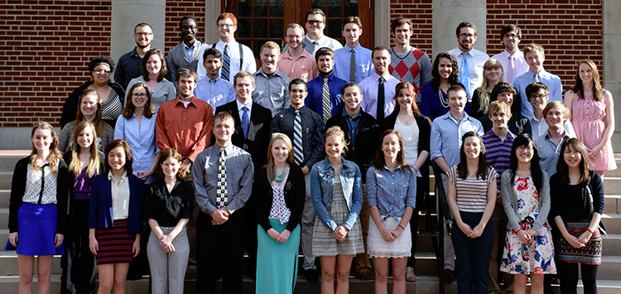
What to Provide
3. Chronological summary of how they know you from research (positions on the team, skills, abstract titles, and presentations).

Slide 18
What to Provide
4. Talking points they may choose to include in their recommendation. 5. Personal statement.
6. Resume.
7. Your best written work.

Slide 19
What to Provide
8. Stamped self-addressed envelopes for directly mailed recommendations. 9. Plain envelopes for recommendations you will return in a bundle.

Slide 20
What to Provide
10. Master checklist (1) program name, description from its website, and specified qualifications (2) due date (3) submission (online links, faculty mail, or student bundled mail)

Slide 21
To Waive or Not To Wave
Always waive the right to review to show your trust in your recommender and ensure a recommendation’s credibility with grad programs and REUs.

Slide 22
Trust, but Verify
Never assume that your recommender has remembered to write your letter. Politely inquire about completion of your letter after 4 weeks.

